Slide 1
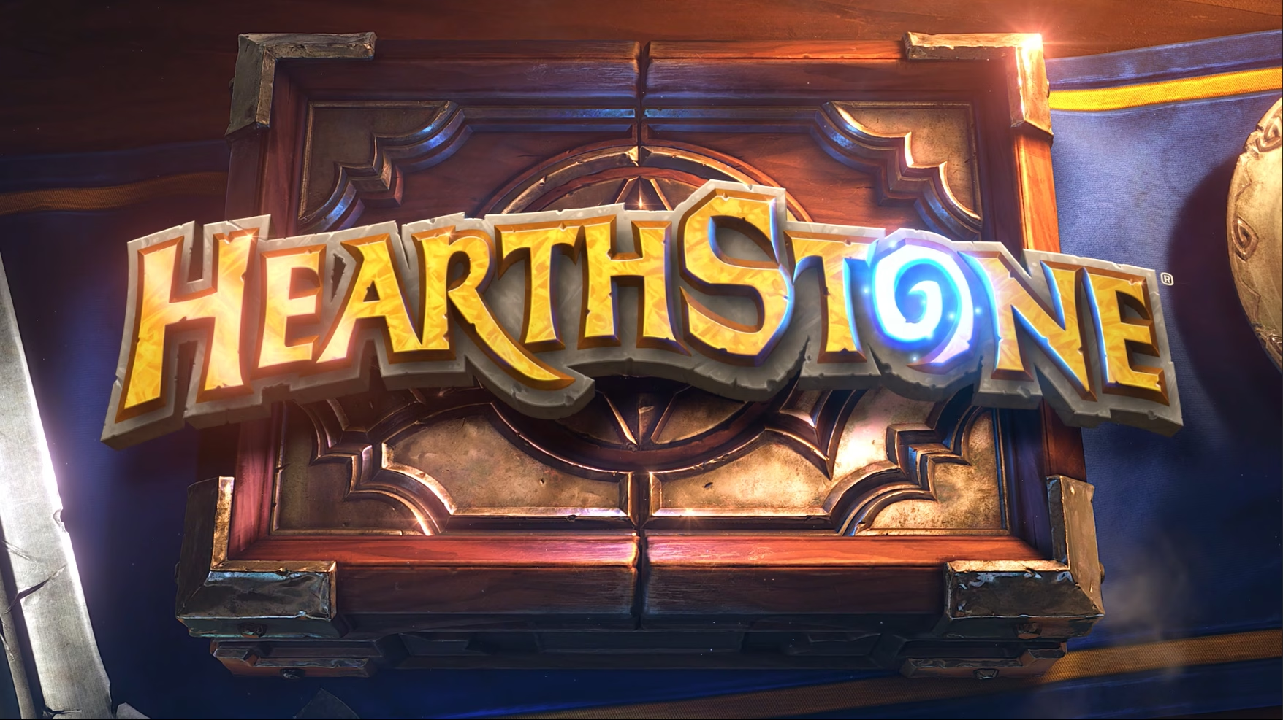
Unveiling Hearthstone's Power
Unveiling
A Study of Power Balance Through the Years
Caique Fabris
Notes:
Introduce yourself and the topic.
"Today, I’ll be talking about power levels in Hearthstone, a digital collectible card game from Blizzard. Many players describe the feeling of power level having gradually increased throughout the game’s history, so I decided to take a closer look at the data and investigate it.”

Slide 2
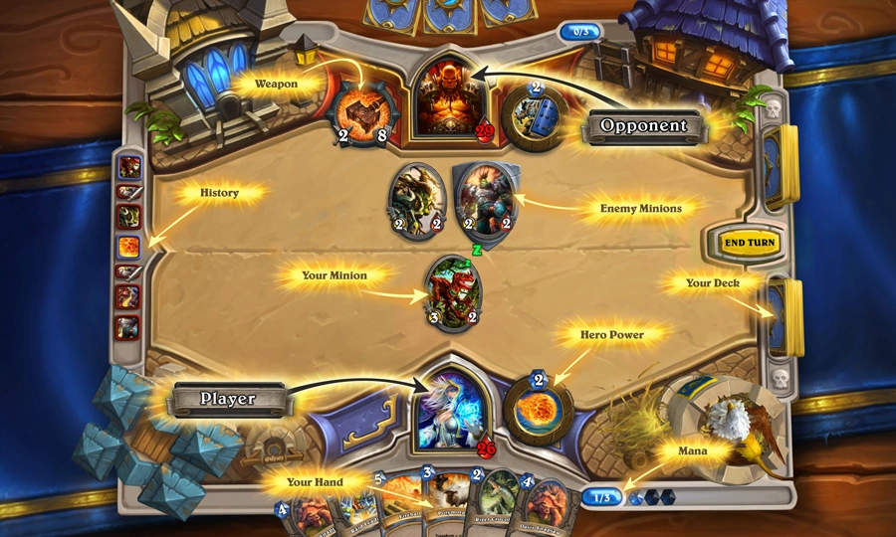
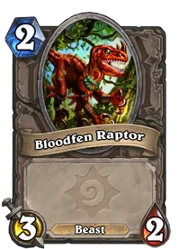
Notes:
Introduce Hearthstone:
"For those unfamiliar, Hearthstone is a turn-based card game where players build decks of cards to compete. Each card has a cost in mana, and many cards have stats in the form of Attack and Health. Cards can also have effects that trigger when played."
Show the board: player / opponent, deck, cards in hand, card types (minions, spells, etc), turn, life points, finalize with minion cards anatomy.

Slide 3
ANATOMY OF A “MINION” CARD
Notes:
Anatomy of a minion card:
Mana Costa (always blue)
Attack Value (always yellow)
Health Value (always red)
These are the ones relevant for us by now

Slide 4
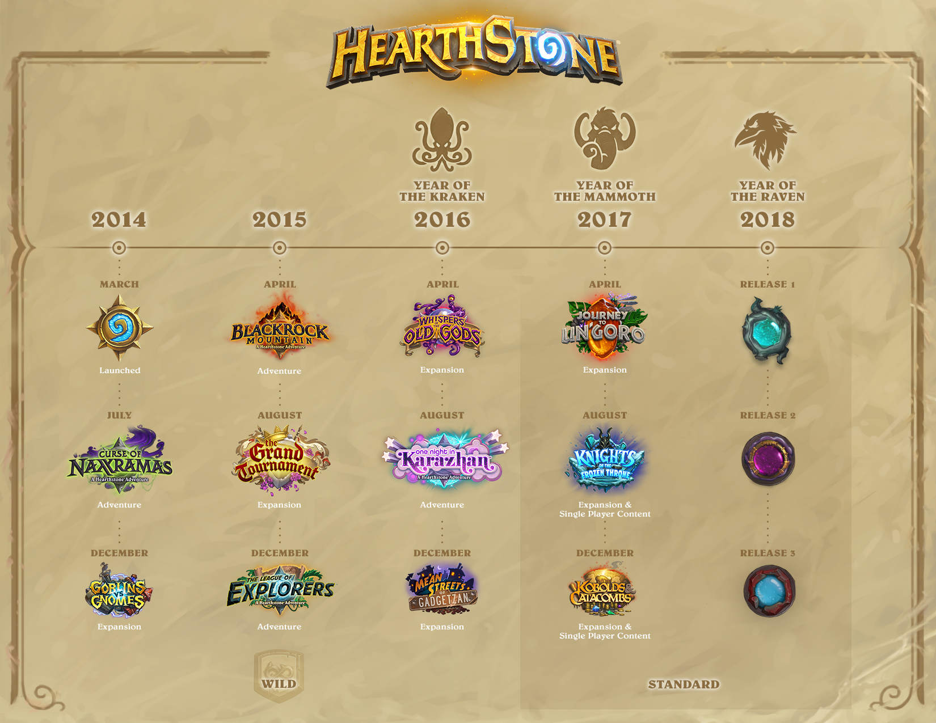
Notes:
Card pool development and the concept of “Power Creep”.
"Hearthstone is continually expanding its card pool, with new expansions released between two and four times a year. Each expansion introduces new cards, mechanics in form of unique card effects, and interactions that refresh the gameplay experience."
“Some senior players describe the feeling that the average power level of the cards has increased throughout the game history, a know phenomena in card-games known as Power Creep.”
"Power creep refers to the phenomenon where new cards are designed to be more powerful than older cards, leading to an increase in overall power levels within the game."
Why does this happen?
"1. Player Expectations: As players become more experienced, they often seek greater challenges and more impactful cards. Game developers respond by designing cards that feel stronger."
"2. Changing Overall Gaming Experience: With new strategies emerging, older cards may become less effective, prompting the need for newer, more powerful options to balance the gameplay."
"3. Encouraging Deck Diversity: New cards must offer compelling reasons to be included in decks, necessitating a power boost to keep up with older cards."

Slide 5
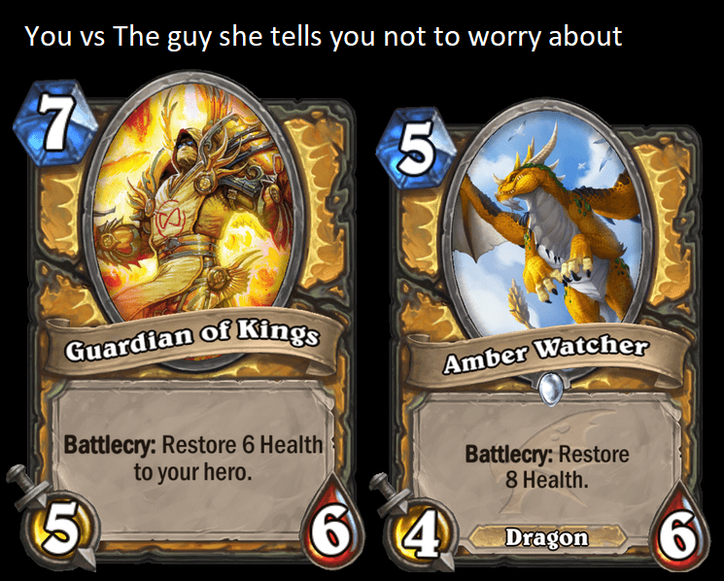
Notes:
Illustration of a Power Creep
Guardian of Kings released date: 2014 (Classic)
Amber Watcher released date: 2019 (Descent of Dragons)
“Feeling that newer cards might replace older ones by being better versions of them”

Slide 6
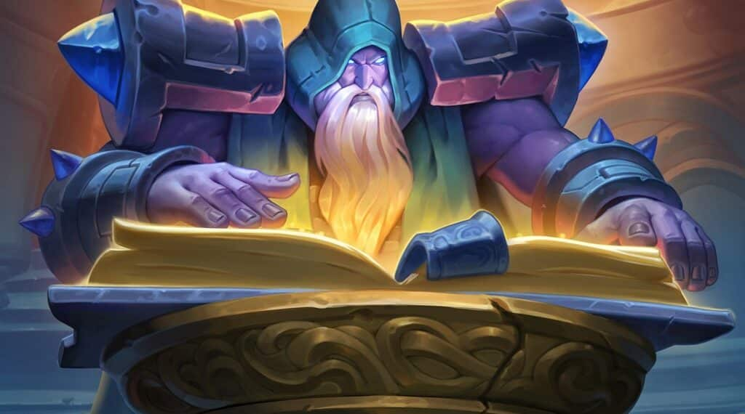
Notes:
Drawing the Hypothesis
“So I decided to dive in the data and investigate what exactly is causing this feeling of Power Creep”

Slide 7
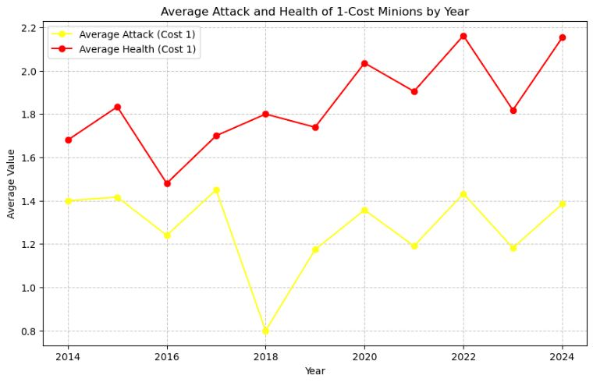
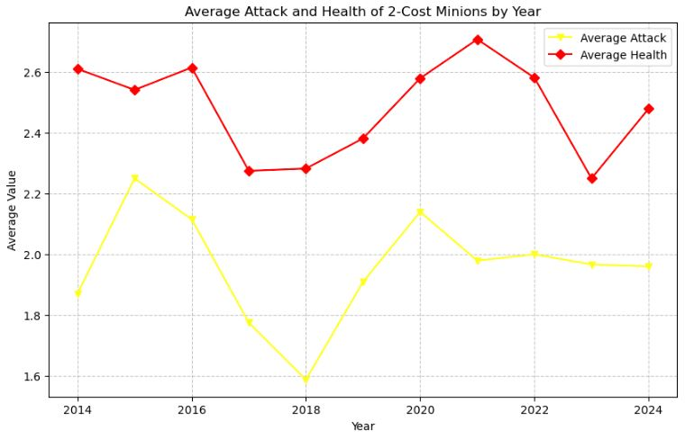
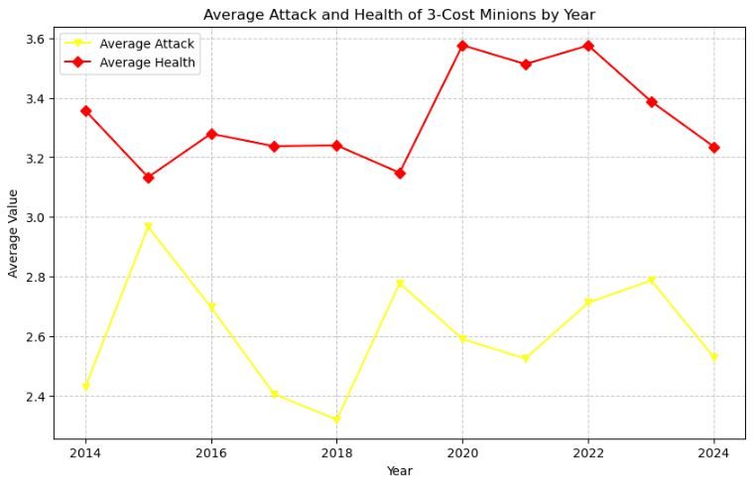
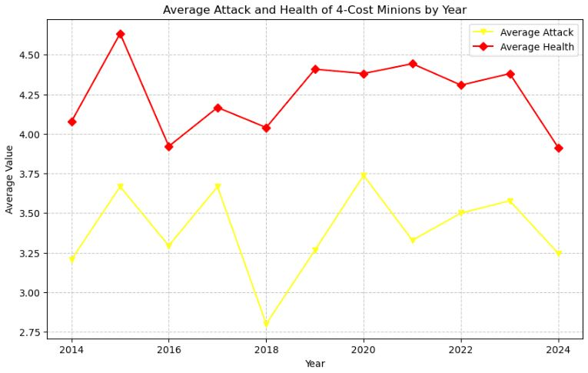
Notes:
"I started by looking at the basic stats of minions over time—Attack and Health. If power creep exists, we might expect to see stats steadily increasing."
“I first broke the plotting down to minion cost because the dataframe was too big (Hearthstone has almost 7K collectible cards as of now), and this way, I thought I could take a closer look at what is happening to minions stats.”
“Turns out, stats-wise, minions remained relatively stable over the course of the game history. In fact, we can observe moments were these endpoints actually decreased! (2018).”

Slide 8
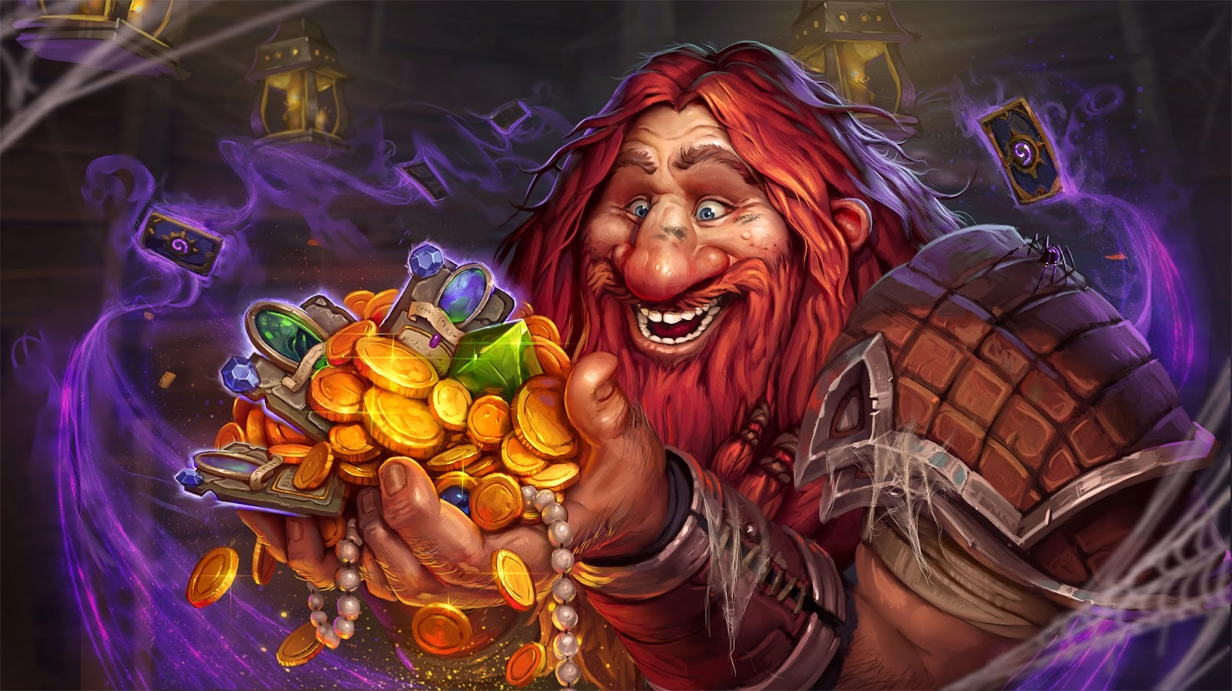
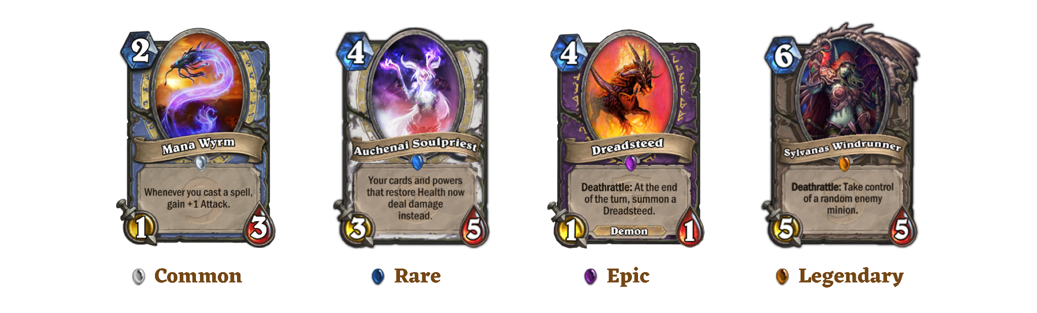
Notes:
Introduce concept of rarity and relate it to power level
“But then I realized that there’s more to consider beyond just stats and costs. Many factors contribute to a card’s competitiveness in Hearthstone. One significant aspect is the rarity of the cards, which ranges from common to rare, epic, and legendary. Generally, the rarer the card, the more powerful we expect it to be. This expectation stems from the fact that higher rarity cards often have unique effects, stronger stats, or synergistic abilities that can greatly influence the game.”

Slide 9
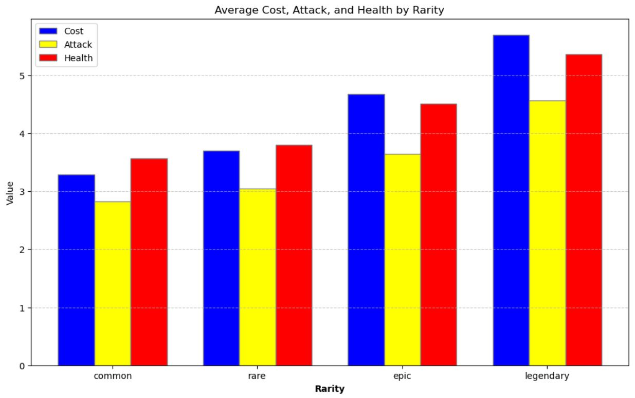
Notes:
“So, let’s plot the average Cost, Attack, and Health of minions by rarity to assess whether the power level is consistent across different rarities. Here’s the average of these metrics without considering any changes over time. This will help us determine if the power levels are truly balanced among them.
Surprisingly, we see that while legendary minions have a higher average cost, their increase in average Attack and Health doesn’t align with that cost. This observation again challenges our initial hypothesis about power creep.”
"However, upon examining how the increase in mana cost didn't correlate with an increase in overall stats, I decided to investigate the efficiency of mana spent on stats. This analysis will help us understand how effectively each card's mana cost translates into its Attack and Health values. Maybe that changed over time."

Slide 10
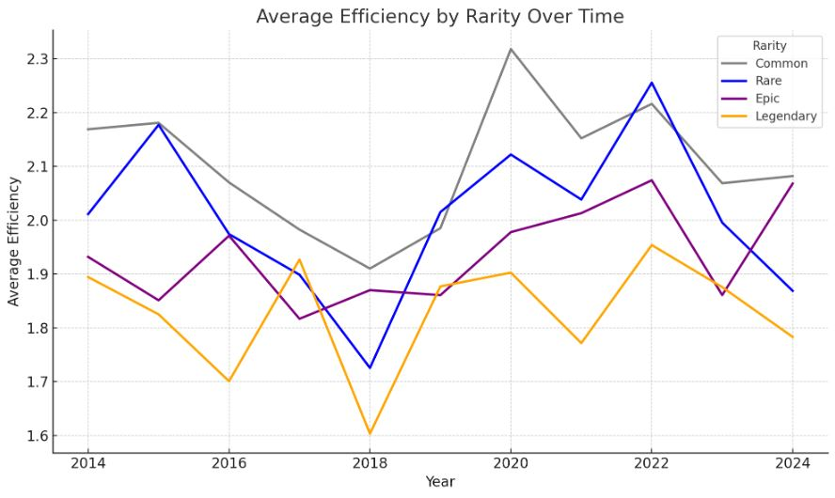
Efficiency = (Attack + Health) / Mana Cost
Notes:
How is the Mana being spent then?
"I decided to track how mana has been spent on stats over the years. Efficiency is defined as the ratio of raw stats to mana cost per minion—essentially, how many stats you get for each unit of mana. Has this changed over time? Is this where we find evidence of power creep? The graph shows that efficiency has remained balanced throughout the years. Interestingly, we also observe that Legendary cards, on average, have lower efficiency compared to Commons and Rares."
"This might seem counterintuitive, but Epic and Legendary cards often feature unique effects that reduce their raw stat value to maintain a balanced gameplay experience. These effects are also reflected in their mana cost."

Slide 11
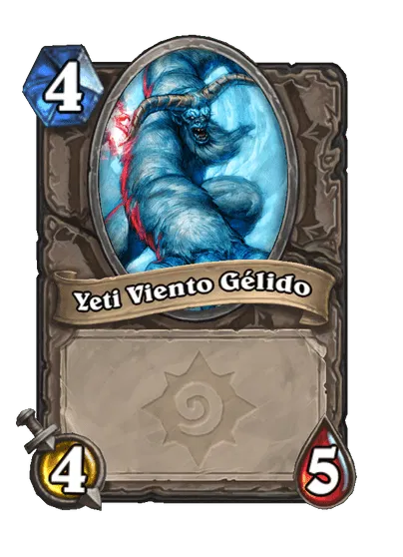
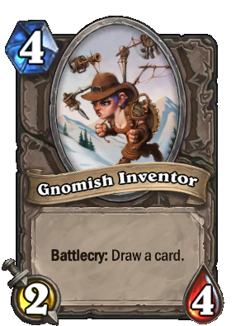
Battlecry: does something when the card enters the board from its owner hand.
“Vanilla” minion
Notes:
"Let’s take two cards from the Classic set: Chillwind Yeti and Gnomish Inventor. Both cost the same amount of mana, but the Yeti provides a total of 9 stats points (4 Attack + 5 Health), while Gnomish Inventor provides only 6, which is 3 points less.
So, how is the mana being spent here? For Chillwind Yeti, each mana point gives you an average of 2.25 total stats. But it’s just a body, as it has no additional effects. In contrast, Gnomish Inventor offers only 1.5 stats per mana. The 3-point difference in stats (2 from Attack and 1 from Health) comes from the effect of drawing a card.
Now, let’s compare the efficiency of minions without effects to those with a specific effect—namely, 'draw a card.'

Slide 12
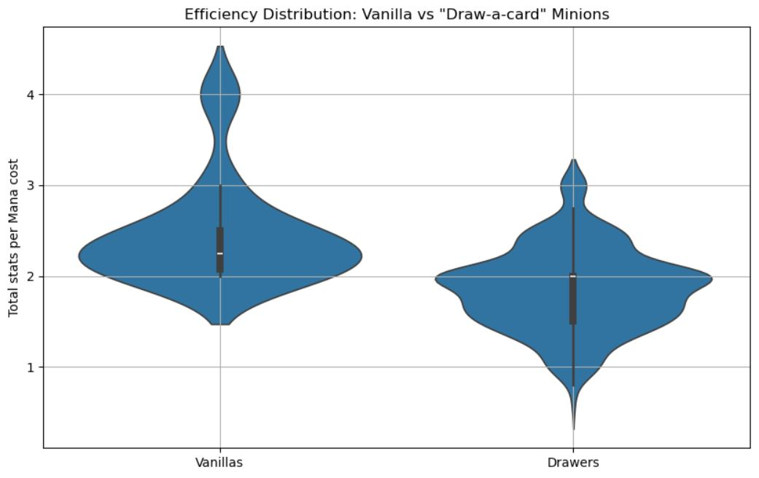
Notes:
"Here, we can visualize how cards without effects tend to have, on average, higher stats compared to cards with effects. Cards that rely solely on stats can reach as high as over 4 points per unit of mana, while cards with the 'draw a card' effect populate a much lower portion on the graph (under 2).
This raises an important question: Could power creep be coming from the fact that effects on cards are getting cheaper? In other words, are we now seeing minions with a 'draw a card' effect that have stats comparable to those of a vanilla minion, without sacrificing as much in terms of raw stats?”

Slide 13
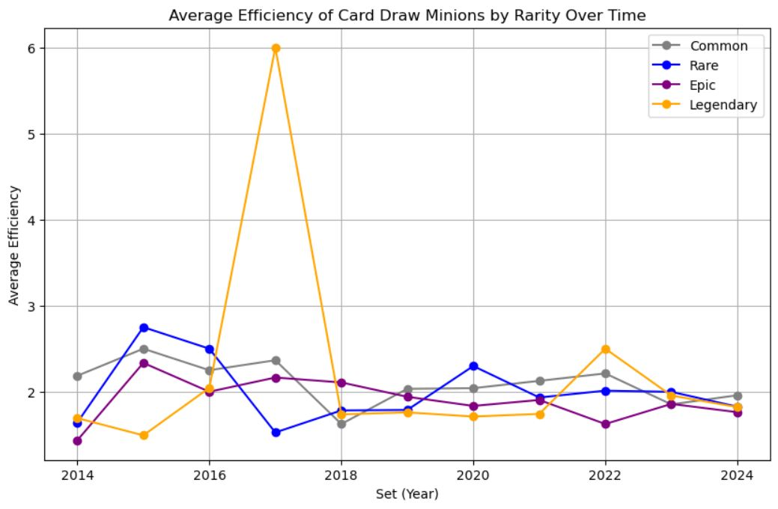
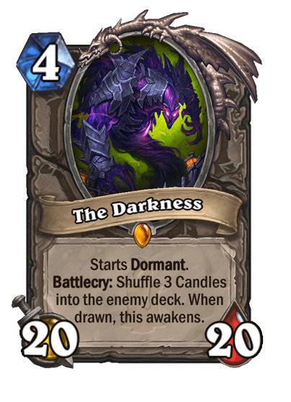
Notes:
“Finally, this hypothesis is also falsified when we plot the efficiency of minions over time. Stats-wise, they have also remained balanced over the games 10 years history.”
“Worth of mentioning the little outlier there”

Slide 14
Conclusions:
The feeling of “Power Creep” cannot be assigned to static measurements such as minion stats and their ratio per Mana cost.
Hearthstone game matches rely heavily on card combos and interactions, with synergies that makes it very challenging to track.
Blizzard made an excellent job regarding game balancing throughout its history.
Further investigations might include additional information over cards, gathered through gameplay, for example, card winrate, as to better evaluate card impact on the course of a match.

Slide 15
Challenges:
Resource (Hearthstone API) went down in the middle of the project, and I had to find another data source.
The new data source was not structured the same way, and it was also way dirtier. Functions I developed to work with the first data frame wouldn’t work with the new one. So I had to start all over.
How to analyse a game that is dynamic and rely heavily on card interactions and synergy using static measurements? The hypothesis was not correctly represented by the parameters I chose to evaluate.

Slide 16
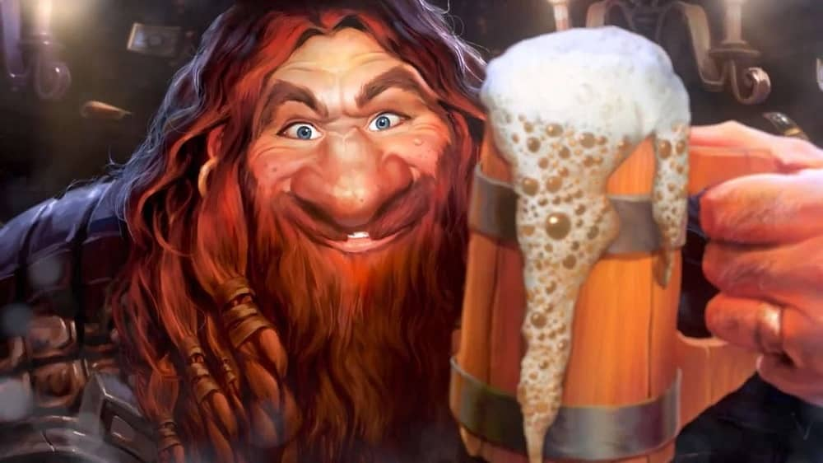
Thank you and well played!

